Slide 1

Costs and benefits of eye movements
Alexander C. Schütz
Notes:
26 Minuten
25 Minuten

Slide 2
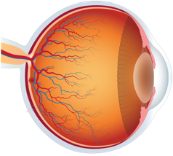

Interaction of perception and eye movements
Perception during pursuit
Peri- & transsaccadic perception
modulates
controls
Eye
movements
Visual Perception
Adaptation of saccades and pursuit
Visual search

Slide 3



Slide 4


Slide 5
Control of eye movements
Schütz, Braun & Gegenfurtner, 2011

Slide 6
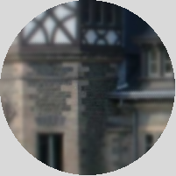

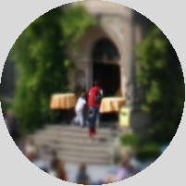
Costs and benefits of saccadic eye movements
Costs
Benefits
Saccadic suppression (Dodge, 1900; Hoppe & Rothkopf, 2016)
Opportunity costs (Abekawa et al., 2021)
Effort (Araujo et al., 2001)
Temporal costs (Irons & Leber, 2016)
Advantages of foveal vs. peripheral vision:
Intrinsic object properties:
How are search costs and information gain traded-off in visual search?

Slide 7
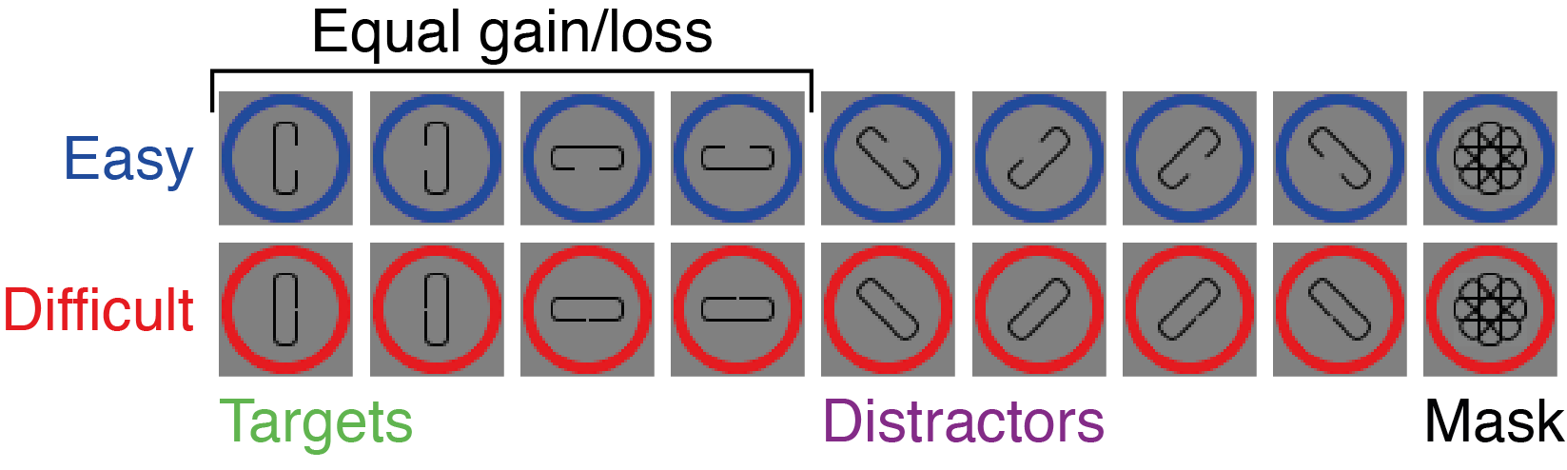


Study 1: Experimental paradigm
Wagner, Henare, Tünnermann, Schubö & Schütz, AP&P, 2022

Slide 8
Ideal observer model
What to search?
Target with higher value, i.e. higher gain per unit of time:
How to search?
Only sample information from the set of the chosen target
$value= \frac{gain}{time}=\frac{\left(proportionCorrect∙reward\right)+(\left[1−proportionCorrect\right]∙penalty)}{{N_{DistractorsInSet}}/2∙searchTime+nonSearchTime}$
$$Δvalue={value}_{easy}−{value}_{difficult}$$
Notes:
Time → Time it takes an INDIVIDUAL participant to find the chosen target among distractors
Critically
We assume participants know about their individual performance limitations
And they decide which target to search for at trial start, before making any saccade
Second question: how to search for the chosen target?
Only fixating elements during search that provide instrumental information for finding the chosen target as quickly as possible
Furthermore, since the ideal observer acts optimally, factors such missing a target (i.e., fixating it but still continuing search) or fixating the same stimulus multiple times are explicitly neglected, since they result in suboptimal behavior.

Slide 9
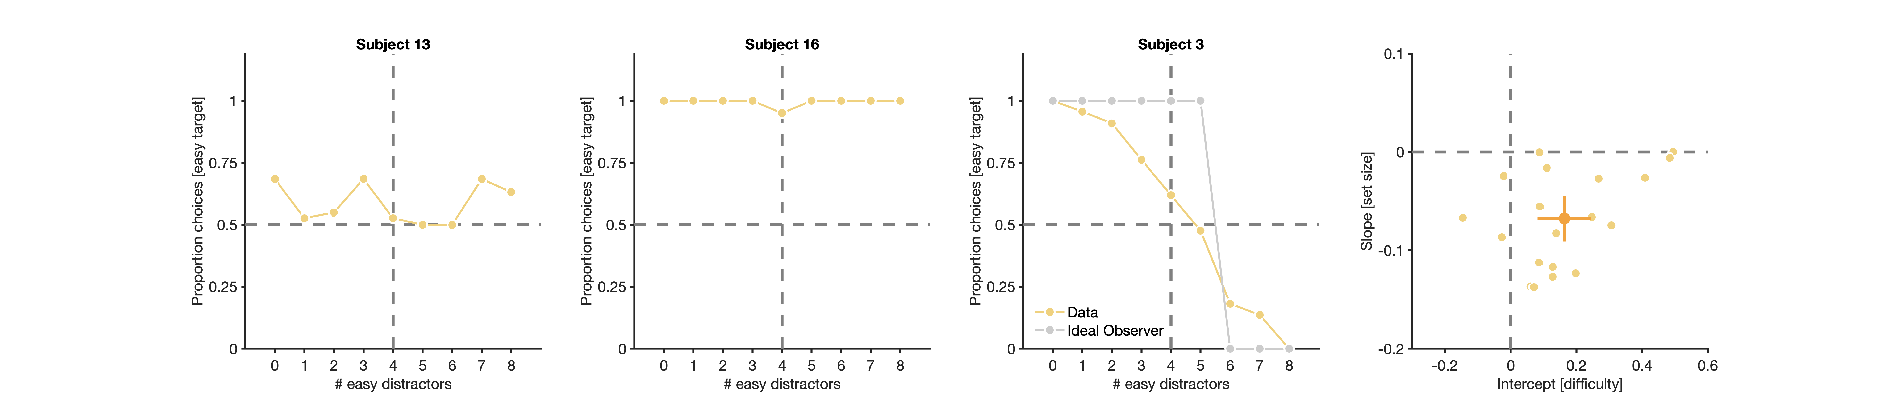
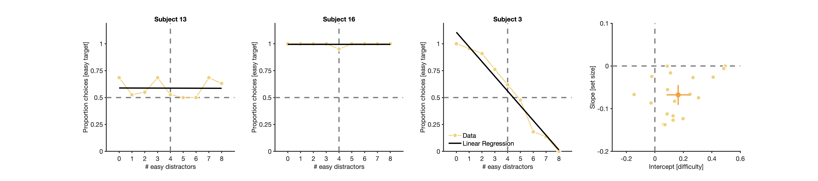
What to search: Target choices
N=19
Target choices are influenced by difficulty and set size, but not quite optimally
Notes:
We found variations in the strategy that participants used to choose which target to search for
Participant 3
Positive normalized intercept
Participants preferred targets with low over targets with high informational value when only few easy distractors were shown
Negative Slope
Preference changed the higher the costs of searching for the easy target
→ Most participants adapted their choice behavior to different search display configurations
And considered costs and benefits of saccades when choosing what to search for
Normalization procedure
The regression of easy target choices on number of easy distractors was normalized such that
An intercept of zero corresponds to a perfectly balanced choice behavior (i.e., 50% easy choices at four easy and four difficult distractors).
Therefore, chance performance (0.50) was subtracted from empirical proportion choices for easy targets, and four was subtracted from the actual number of easy distractors before fitting

Slide 10
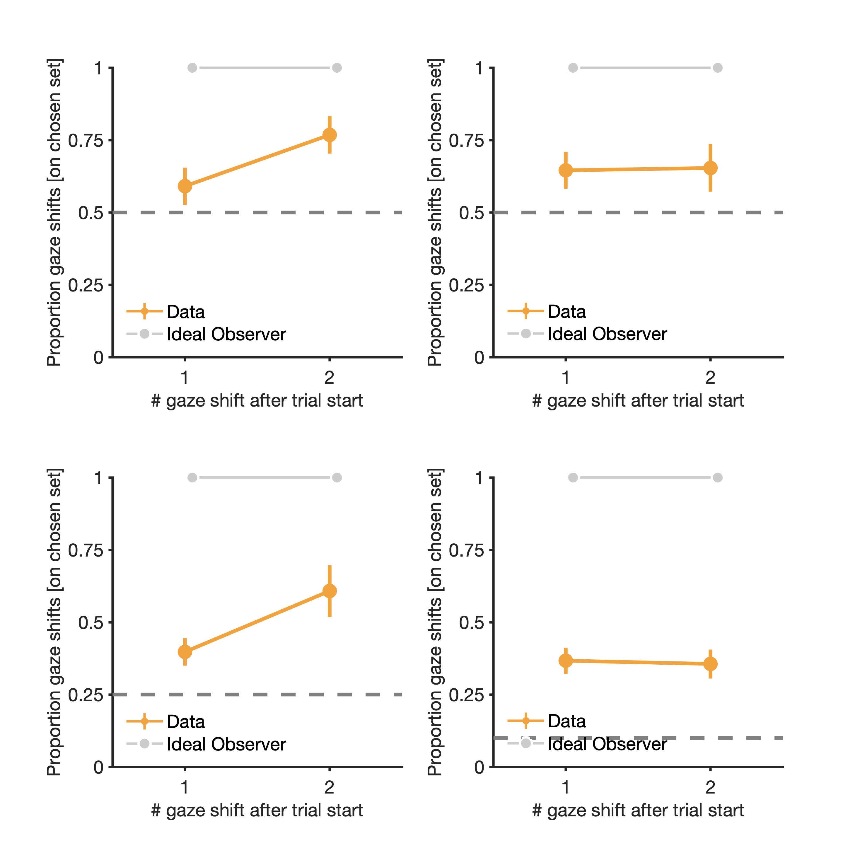
How to search: Sampling of chosen set
Suboptimal target selection of
first saccade (Verghese, 2012)
saccades with short latencies (Schütz et al., 2012)
First saccades do not prefer the chosen set

Slide 11
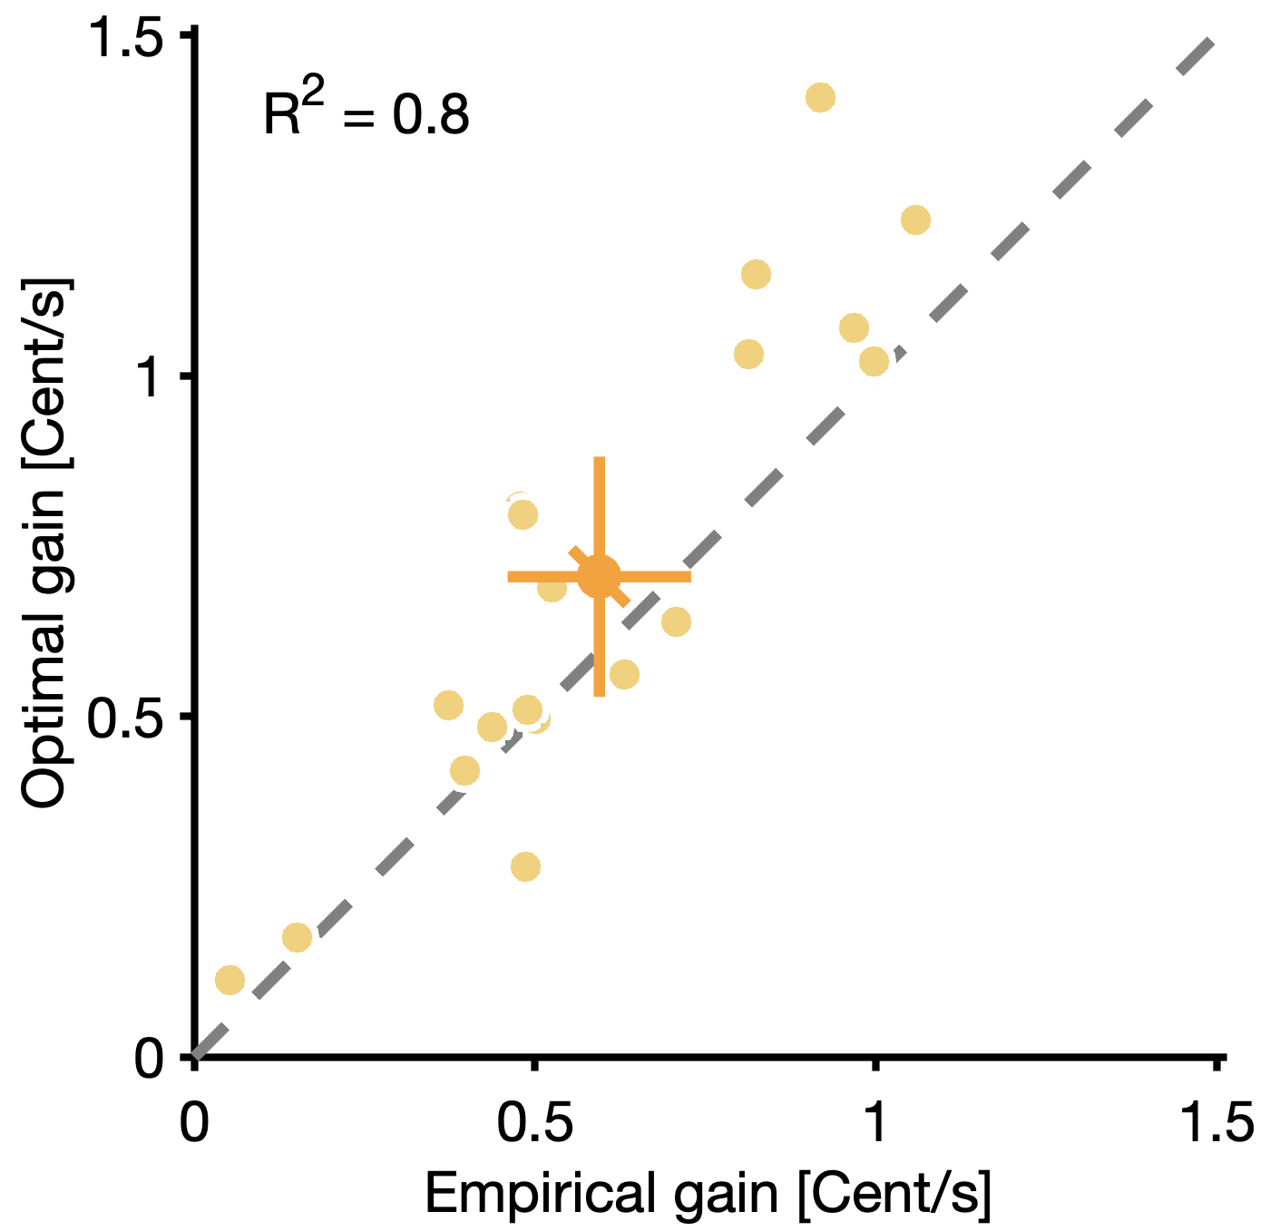
Comparison with ideal observer performance
Overall, slightly suboptimal performance

Slide 12
Extension of model: decision noise and fixation noise
What to search?
Target with higher value, i.e. higher gain per unit of time:
How to search?
Variable fixation bias ranging from completely random sampling to exclusive sampling from chosen set:
$value= \frac{gain}{time}=\frac{\left(proportionCorrect∙reward\right)+(\left[1−proportionCorrect\right]∙penalty)}{{N_{DistractorsInSet}}/2∙searchTime+nonSearchTime}$
$$Δvalue={value}_{easy}−{value}_{difficult} + φ\left(μ=0,σ\right)$$
$$fix_bias=φ\left(Δvalue, μ=0,σ\right)$$

Slide 13
Urn model for fixations
d
d
d
d
d
d
t
t
Random sampling
t
t
Exclusive sampling
2/5
1/5
1/5
1/5
2/3
1/3
d
t
t
d
d
t
1/4
1/4
1/4
1/4
2/4
1/4
1/4
1/2
1/2
d
t
t
d
d
t
t
d
t

Slide 14
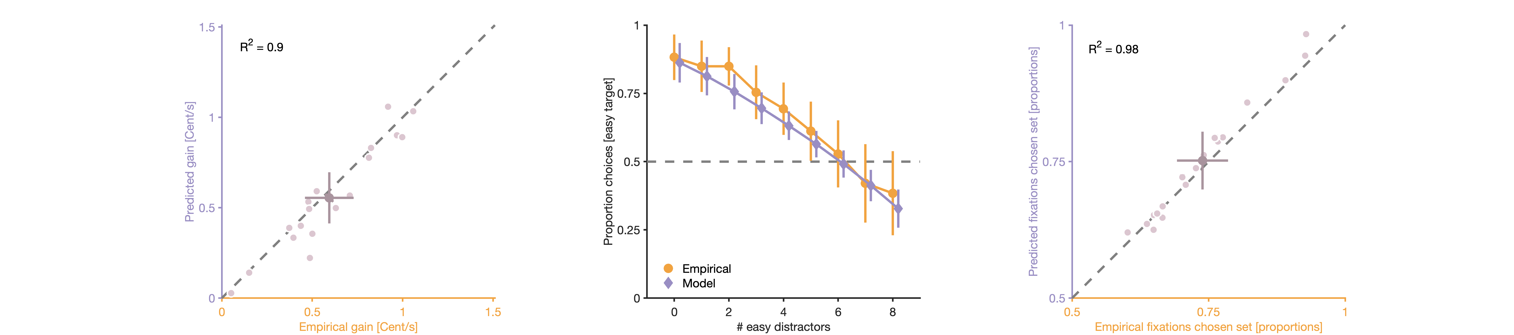
Comparison with extended model
Model with decision and fixation noise can explain what and how is searched.

Slide 15
Visual vs. manual search
Similar exploration procedures with eyes and index finger (Lio, Fadda, Doneddu, Duhamel & Sirigu, 2019).
Planning of longer sequences and more optimal path length in foraging with hands than eyes (Diamond, Wolpert & Flanagan, 2017).
Eyes
Finger
Notes:
Similarity of visual search with eye movements and manual search with index finger

Slide 16
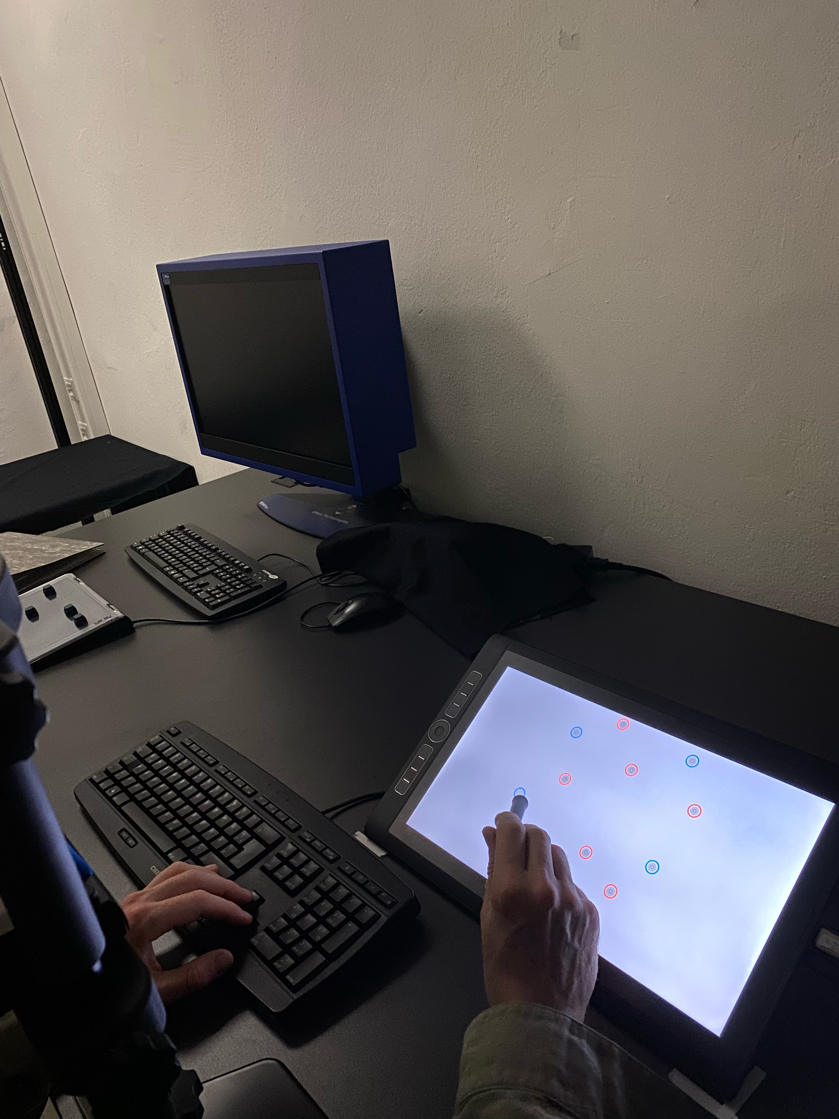
Study 2: Setup for manual search
Wagner, Tünnermann, Schubö & Schütz, in prep.

Slide 17
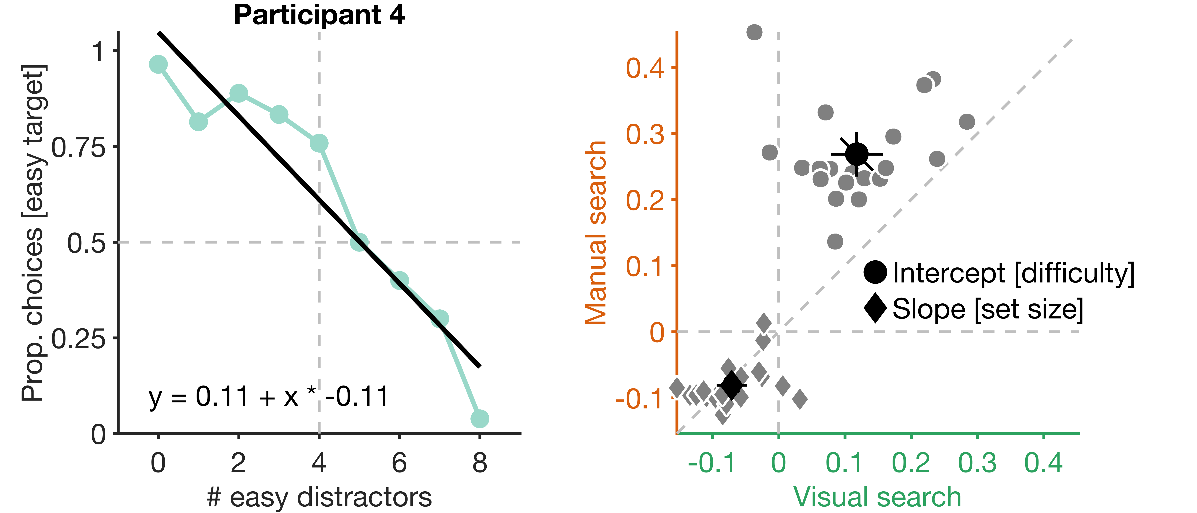
What to search: Target choices
N=20
Both, visual and manual search are influenced by difficulty and set size

Slide 18
How to search: Sampling of chosen set
Suboptimal first movement in visual, but not in manual search

Slide 19
Comparison with ideal observer performance
Optimal performance in manual, but not visual search

Slide 20
Estimated noise values
Larger noise contribution in visual than in manual search

Slide 21
Summary
Humans trade-off costs and information gain of saccades when choosing which target to search and discriminate.
Performance was constrained by noise in decisions about what and how to search.
Less noise and more optimal target selection in manual than in visual search.
Saccades prioritize fast over optimal target selection

Slide 22
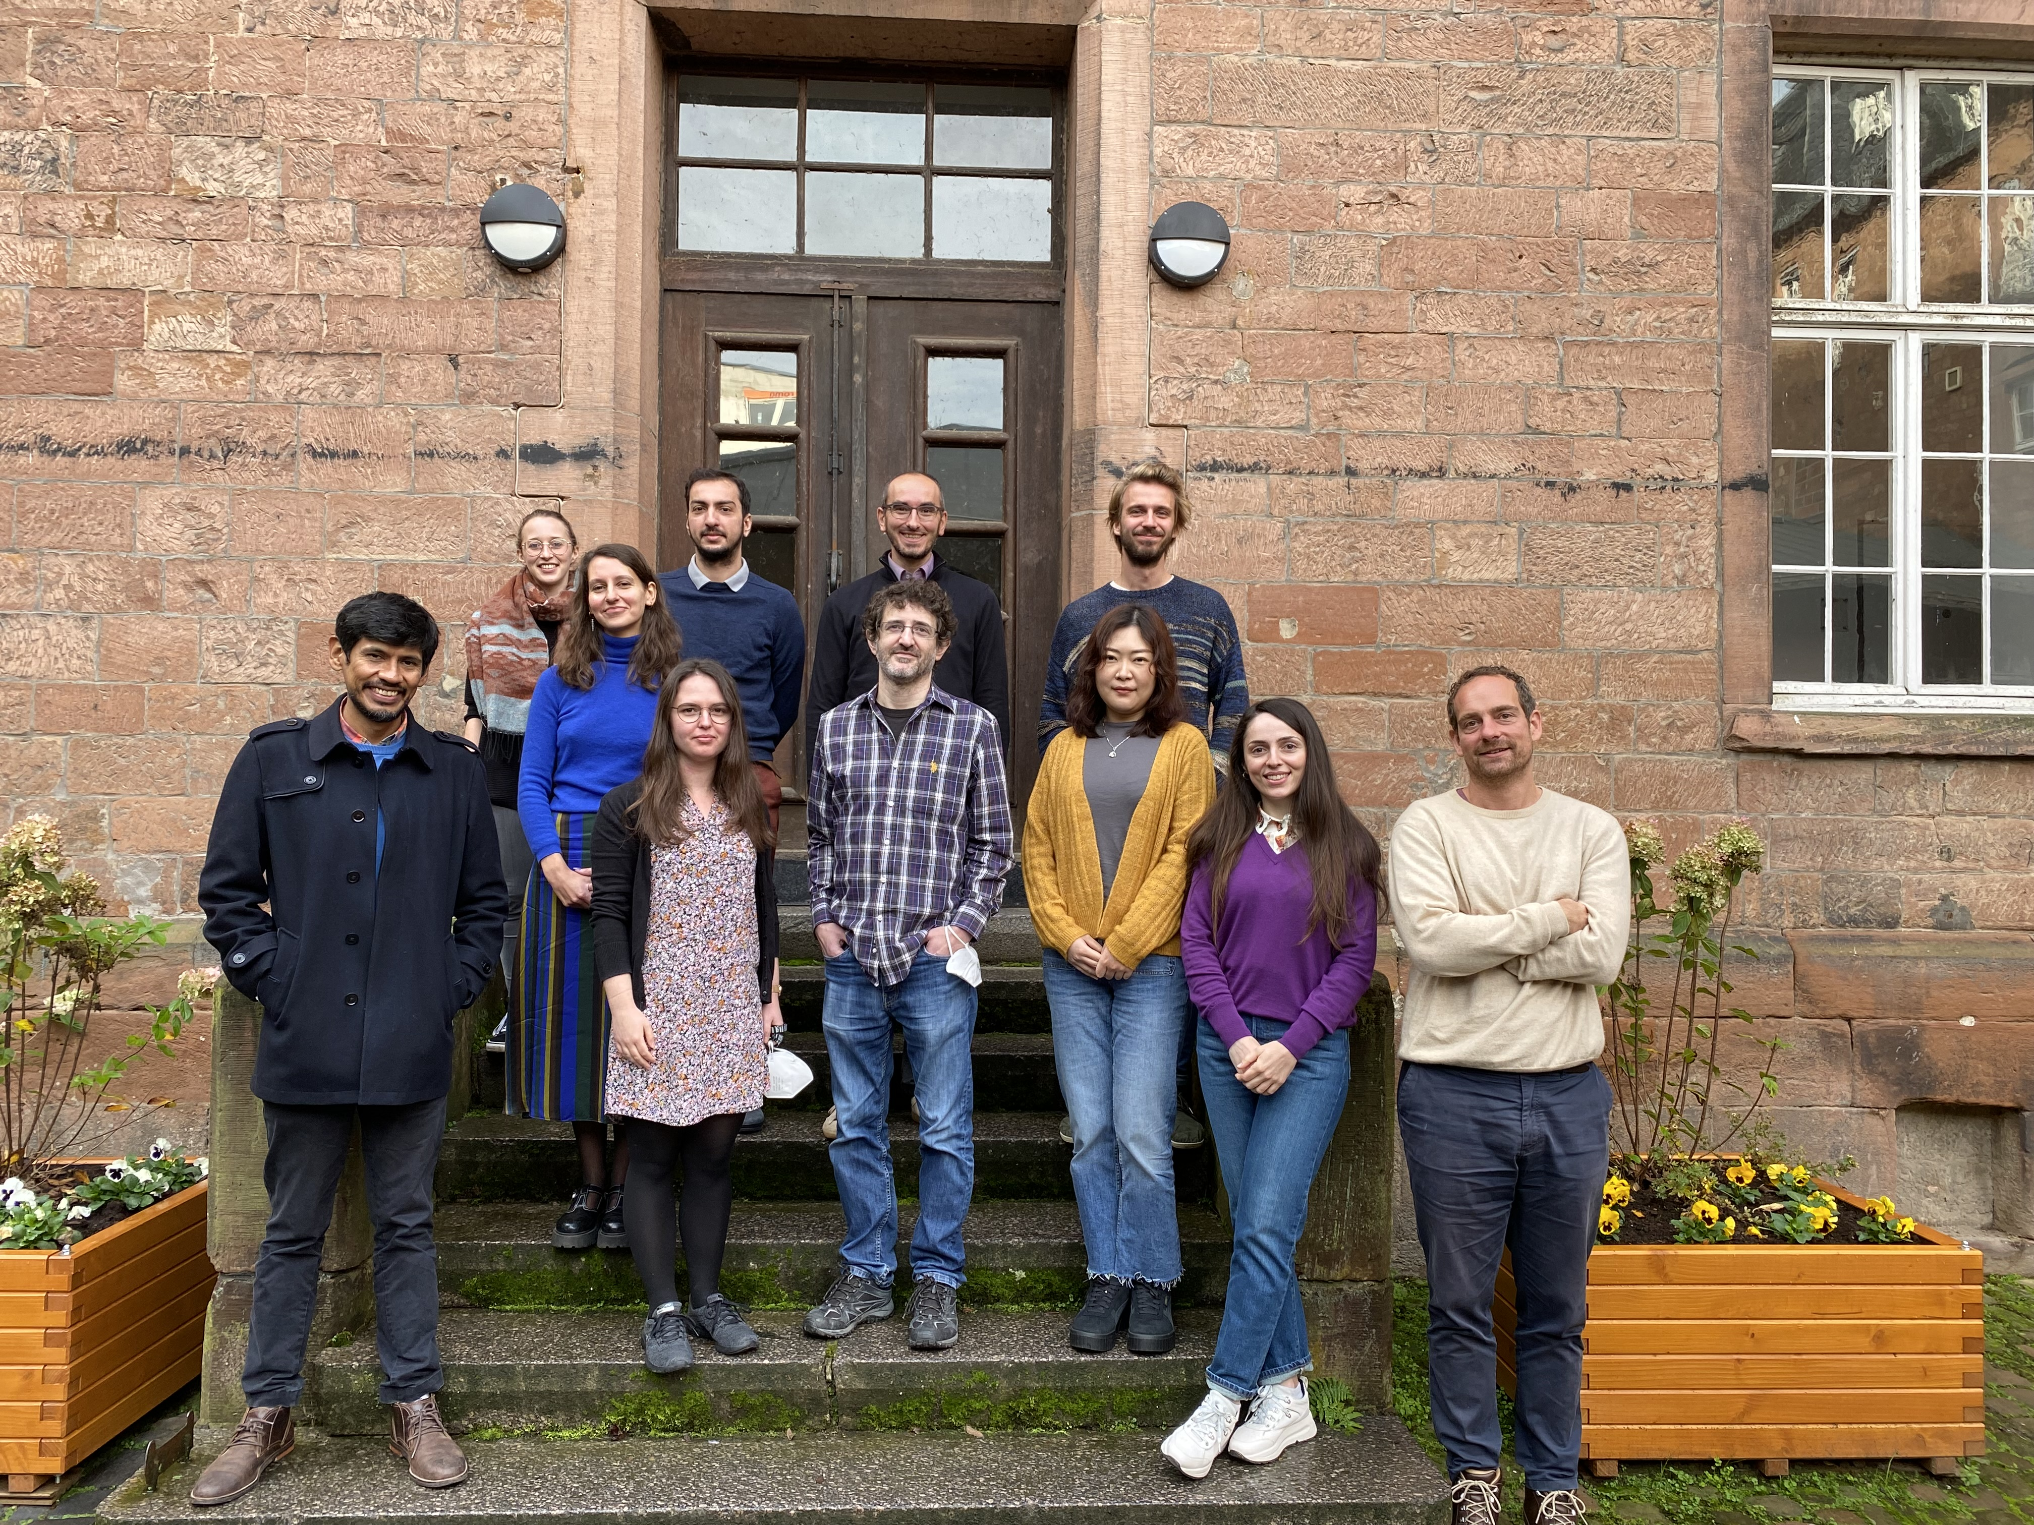

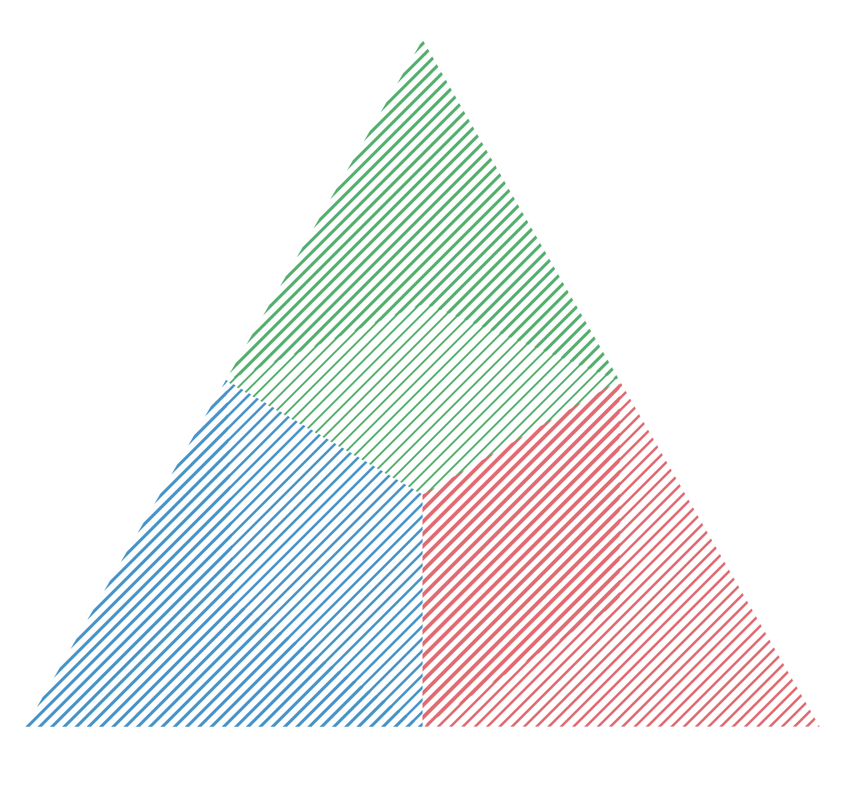


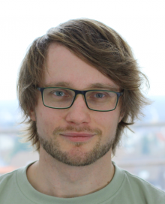
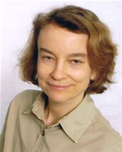



Thank you
Cardinal Mechanisms of Perception
Dion Henare
Jan Tünnermann
Anna Schubö
Ilja Wagner

Slide 23
Baseline values
Large individual differences in discrimination performance and search costs

Slide 24
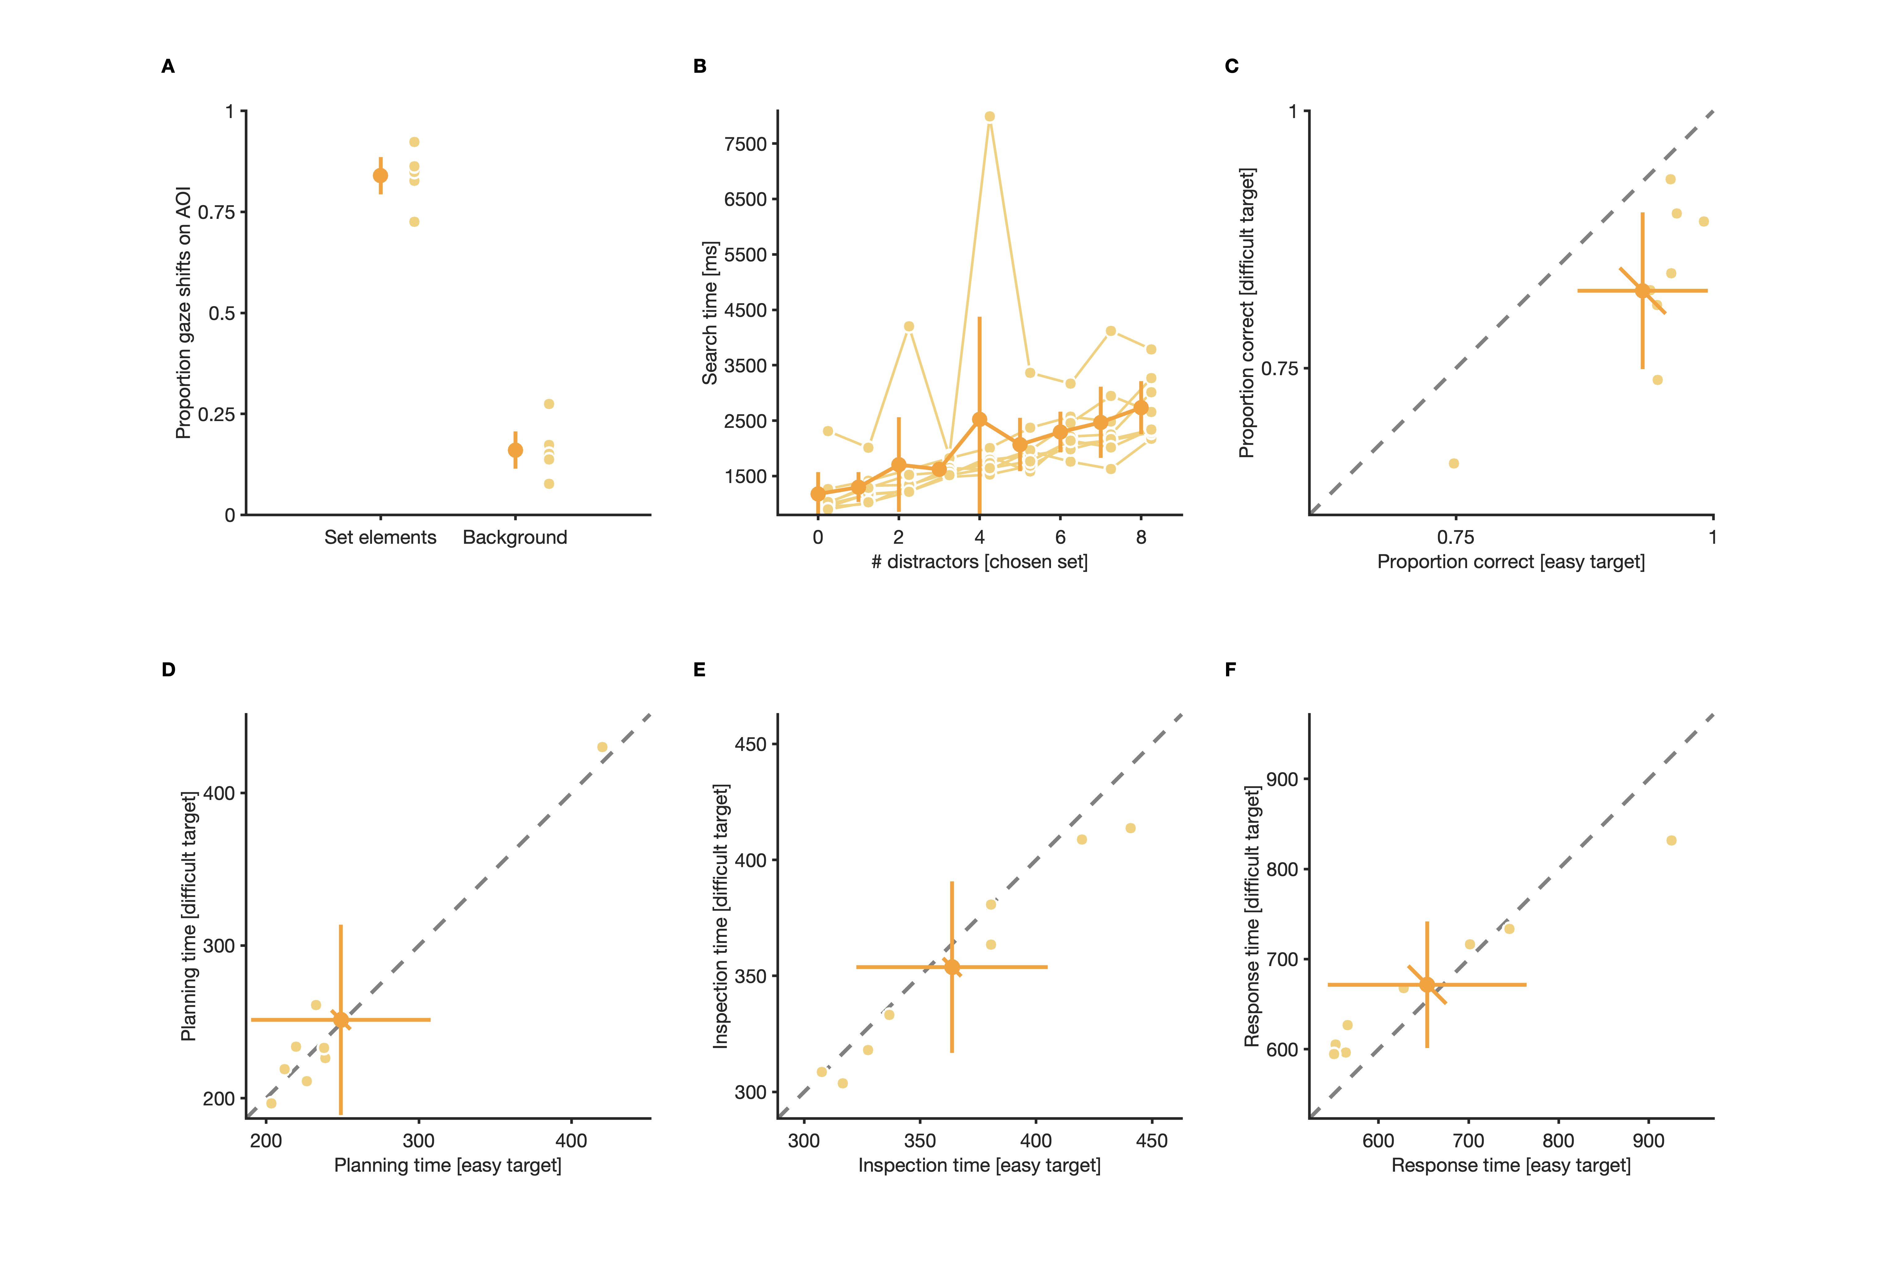
Visual search

Slide 25
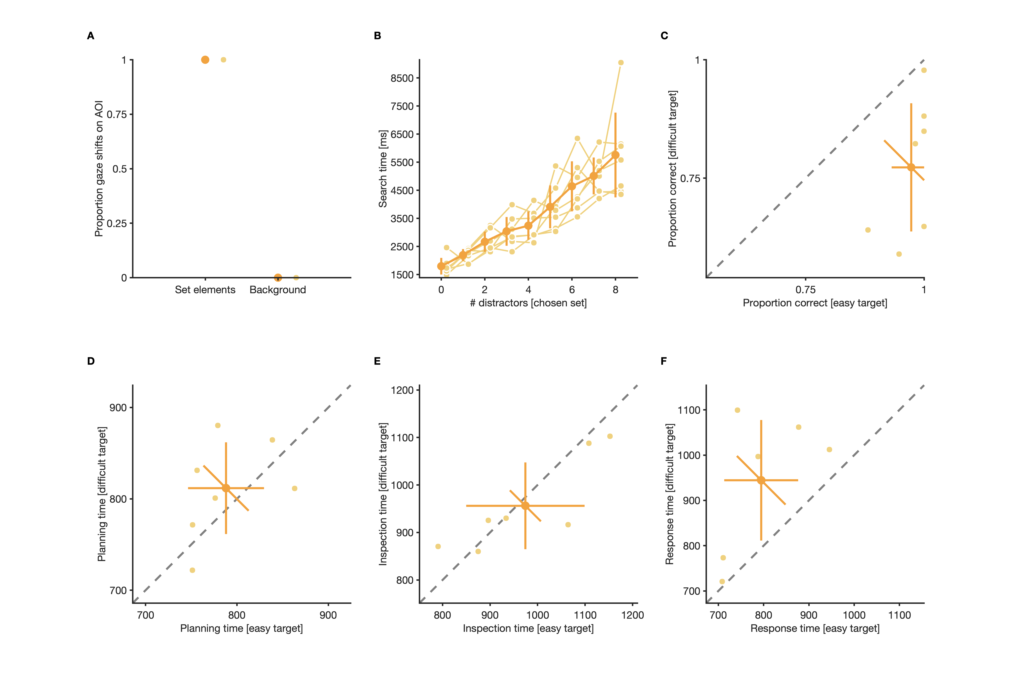
Manual search

Slide 28

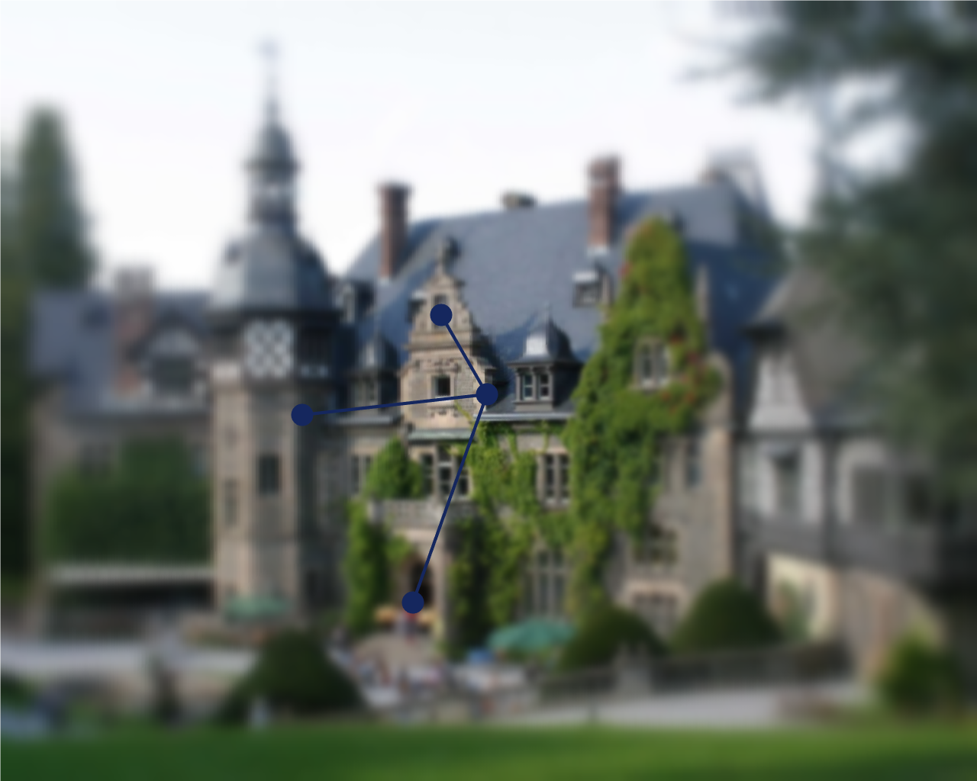


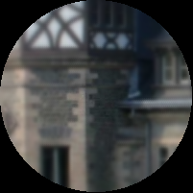
Presaccadic, peripheral
Perisaccadic input
Postsaccadic, foveal

Slide 30
Costs and benefits of saccadic eye movements
Costs
Saccadic suppression (Dodge, 1900; Hoppe & Rothkopf, 2016)
Opportunity costs (Abekawa et al., 2021)
Effort (Araujo et al., 2001)
Temporal costs (Irons & Leber, 2016)
Benefits
Advantages of foveal compared to peripheral vision
Intrinsic object value
How are search costs and information gain traded-off in visual search?
Notes:
7 Minuten bis Ende dieser Folie

Slide 31


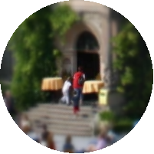
Information gain of eye movements
Often related to differences between peripheral and foveal vision:
Also determined by the information content of an object:
Notes:
Ab hier 17 Minuten

Slide 32
Costs of eye movements
Saccadic suppression (Dodge, 1900; Hoppe & Rothkopf, 2016)
Opportunity costs (Abekawa et al., 2021)
Effort (Araujo et al., 2001)
Temporal costs (Irons & Leber, 2016)
How are information gain and search costs traded-off in visual search?
Notes:
Costs of eye movements; Trade-off between potential gain and costs?

Slide 33
What to search: Target choices
N=19
Target choices are influenced by difficulty and set size, but not quite optimally
Notes:
We found variations in the strategy that participants used to choose which target to search for
Participant 3
Positive normalized intercept
Participants preferred targets with low over targets with high informational value when only few easy distractors were shown
Negative Slope
Preference changed the higher the costs of searching for the easy target
→ Most participants adapted their choice behavior to different search display configurations
And considered costs and benefits of saccades when choosing what to search for
Normalization procedure
The regression of easy target choices on number of easy distractors was normalized such that
An intercept of zero corresponds to a perfectly balanced choice behavior (i.e., 50% easy choices at four easy and four difficult distractors).
Therefore, chance performance (0.50) was subtracted from empirical proportion choices for easy targets, and four was subtracted from the actual number of easy distractors before fitting

Slide 34
Stochastic sampling
d
d
d
Random sampling
d
d
d
Biased sampling
t
t
t
t
2/5
1/5
1/5
1/5
2/3
1/3
0
0
d
t
t
d
d
t
t
d
1/4
1/4
1/4
1/4
2/4
1/4
1/4
1/2
1/2
0
0
d
t
t
d
d
t
t
d
t
t
d

Slide 35
Stochastic sampling
Model with decision and fixation noise can explain what and how it is search.

